Slide 1
SMART HELMET & AUTOMATIC INDICATION LIGHTS
Group 13:
1. LABBI SAI CHARAN - S20190020228
2. P.GAURAV - S20190020237
3.NAVEEN KRISHNA.M - S20190020231

Slide 2
SMART HELMET
To ensure the safety of two wheelers by ensuring that every two wheeler wears a helmet while driving
In this helmet was integrated with arduino bluetooth and proximity sensor . proximity sensor detects the object(head of the person ) and sends data to arduino which communicates with master arduino via bluetooth and send alert to mobile

Slide 3
Contributions
Hardware :- Naveen
Coding part:- Gaurav and Sai charan

Slide 4
Mid evaluation :
End evaluation:
Two bluetooths connection and upload to server
integrating proximity sensor to helmet and mobile app

Slide 5
BLOCK DIAGRAM
POWER SUPPLY
Arduino uno-master(bike)
Arduino uno-slave(helmet)
Proximity sensor
Node mcu
bluetooth
bluetooth
Server
(THINGSPEAK)
mobile

Slide 6
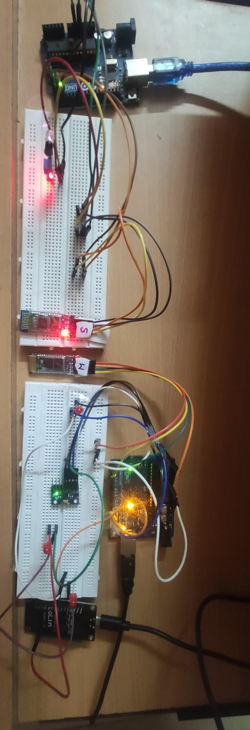
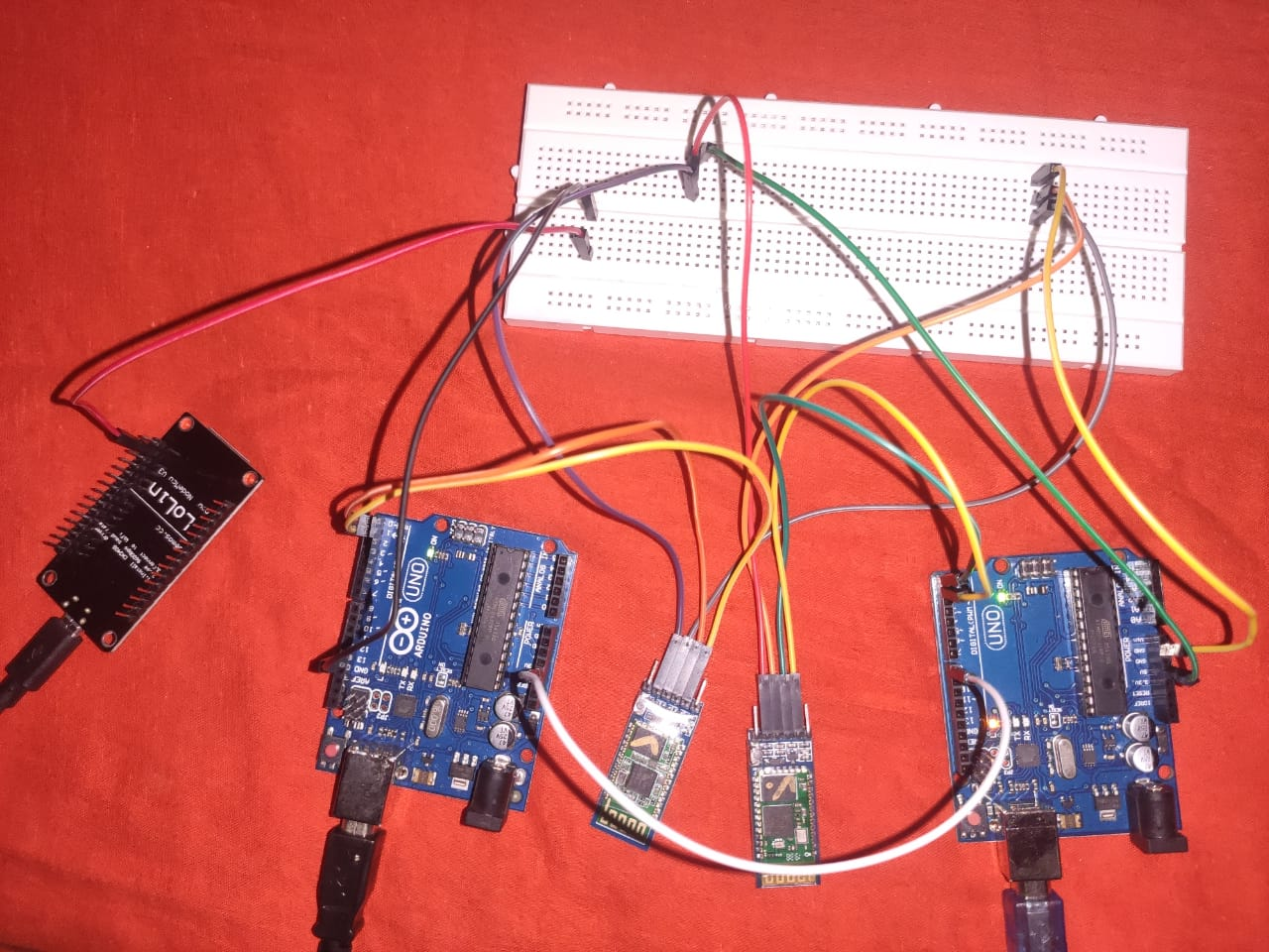
IMAGE OF THE HARDWARE MODULE

Slide 7
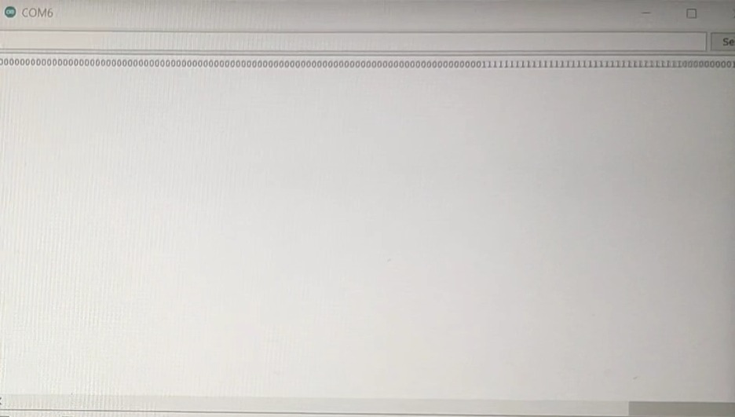
SERIAL MONITOR OF NODE MCU

Slide 8
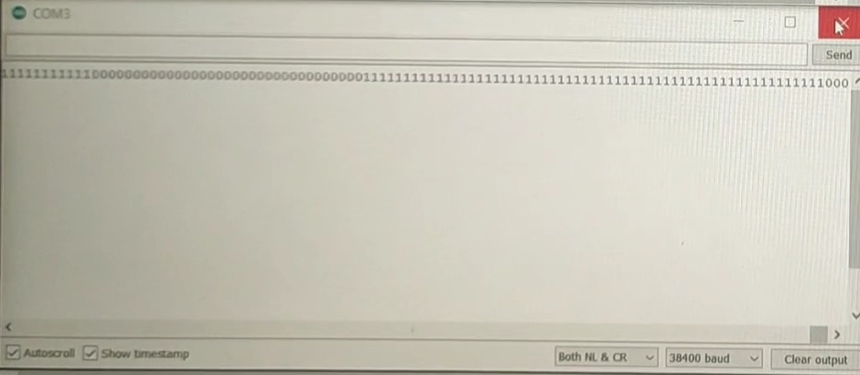
OUTPUTS ON SERIAL MONITOR
SERIAL MONITOR OF SLAVE

Slide 9
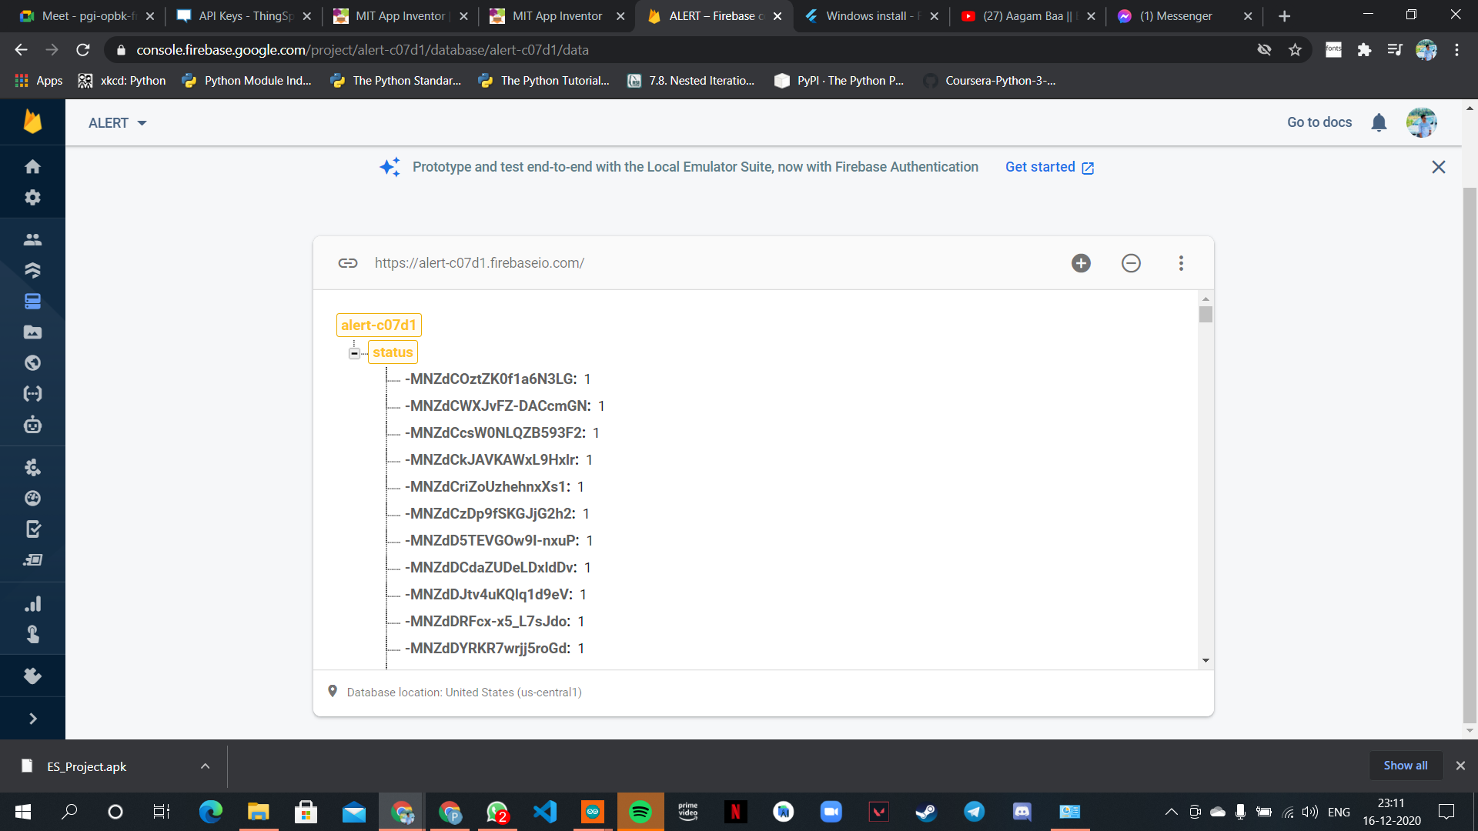
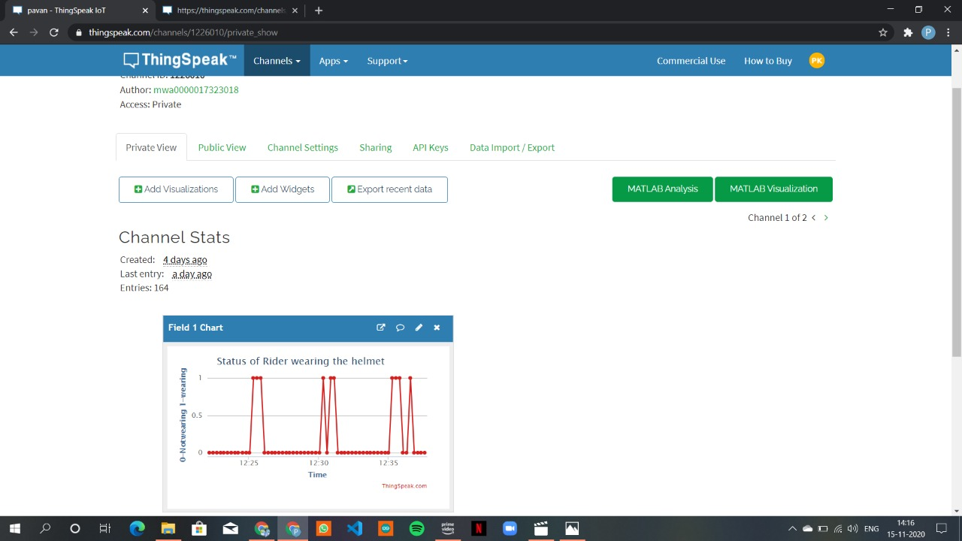
OUTPUTS ON FIREBASE

